Slide 1
Digital Transmission
Data or information can be stored in two ways, analog and digital. For a computer to use the data, it must be in discrete digital form. Similar to data, signals can also be in analog and digital form. To transmit data digitally, it needs to be first converted to digital form.
Digital-to-Digital Conversion
This section explains how to convert digital data into digital signals. It can be done in two ways, line coding and block coding. For all communications, line coding is necessary whereas block coding is optional.
Line Coding
The process for converting digital data into digital signal is said to be Line Coding. Digital data is found in binary format. It is represented (stored) internally as series of 1s and 0s.
The process for converting digital data into digital signal is said to be Line Coding. Digital data is found in binary format. It is represented (stored) internally as series of 1s and 0s. A common real-world example is sending a document from a computer to a printer via a local cable using Manchester Encoding, where voltage transitions embed clock timing directly into the data signal

Slide 2
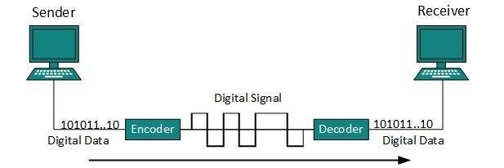
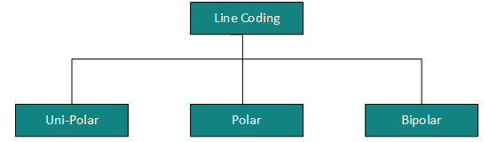
Digital signal is denoted by discreet signal, which represents digital data. There are three types of line coding schemes available:

Slide 3
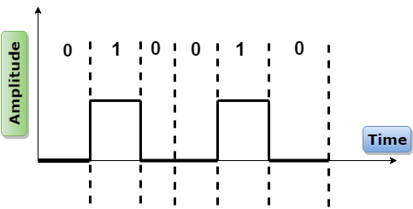
Unipolar
Digital transmission system sends the voltage pulses over the medium link such as wire or cable.
In most types of encoding, one voltage level represents 0, and another voltage level represents 1.
The polarity of each pulse determines whether it is positive or negative.
This type of encoding is known as Unipolar encoding as it uses only one polarity.
In Unipolar encoding, the polarity is assigned to the 1 binary state.
In this, 1s are represented as a positive value and 0s are represented as a zero value.
In Unipolar Encoding, '1' is considered as a high voltage and '0' is considered as a zero voltage.
Unipolar encoding is simpler and inexpensive to implement.
Unipolar encoding has two problems that make this scheme less desirable:
DC Component
Synchronization

Slide 4
The presence of a DC component can cause problems with signal transmission over long distances, while the lack of a built-in clocking mechanism makes it difficult for the receiver to synchronize with the sender's timing.
This DC component can be problematic because it can cause signal distortion and loss of data, especially when transmitted over long distances or through AC-coupled communication systems.
DC (Direct Current) component introduces a zero-frequency(rate of change of signal(voltage) per sec) offset that creates major issues in communication systems.
A DC component represents a constant voltage offset that carries no actual data

Slide 5
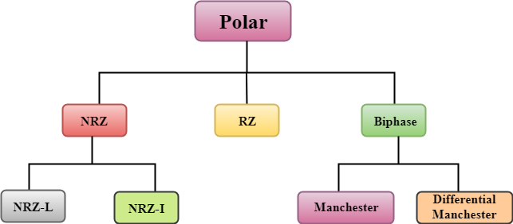
Polar
Polar encoding is an encoding scheme that uses two voltage levels: one is positive, and another is negative.
By using two voltage levels, an average voltage level is reduced, and the DC component problem of unipolar encoding scheme is alleviated.

Slide 6
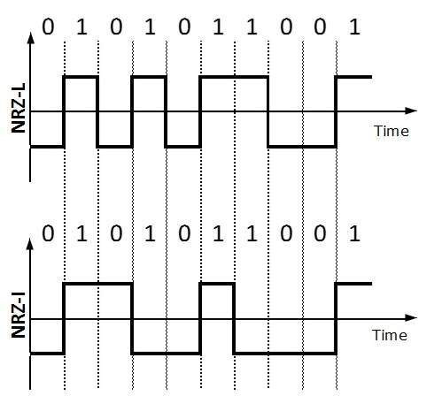
NRZ
NRZ stands for Non-return zero.
In NRZ encoding, the level of the signal can be represented either positive or negative.
The two most common methods used in NRZ are:
NRZ-L: In NRZ-L encoding, the level of the signal depends on the type of the bit that it represents. If a bit is 1 or 0, then their voltages will be positive and negative respectively. Therefore, we can say that the level of the signal is dependent on the state of the bit.
NRZ-I: NRZ-I is an inversion of the voltage level that represents 1 bit. In the NRZ-I encoding scheme, a transition occurs between the positive and negative voltage that represents 1 bit. In this scheme, 0 bit represents no change and 1 bit represents a change in voltage level.
NRZ-L changes voltage level at when a different bit is encountered whereas NRZ-I changes voltage when a 1 is encountered.

Slide 7
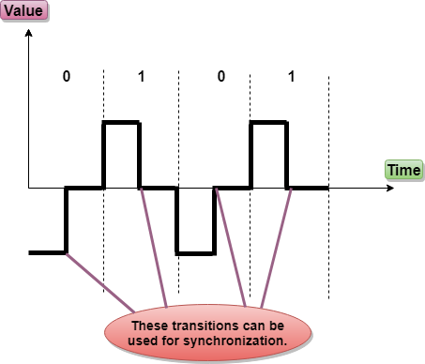
RZ
RZ stands for Return to zero.
There must be a signal change for each bit to achieve synchronization. However, to change with every bit, we need to have three values: positive, negative and zero.
RZ is an encoding scheme that provides three values, positive voltage represents 1, the negative voltage represents 0, and zero voltage represents none.
In the RZ scheme, halfway through each interval, the signal returns to zero.
In RZ scheme, 1 bit is represented by positive-to-zero and 0 bit is represented by negative-to-zero.

Slide 8
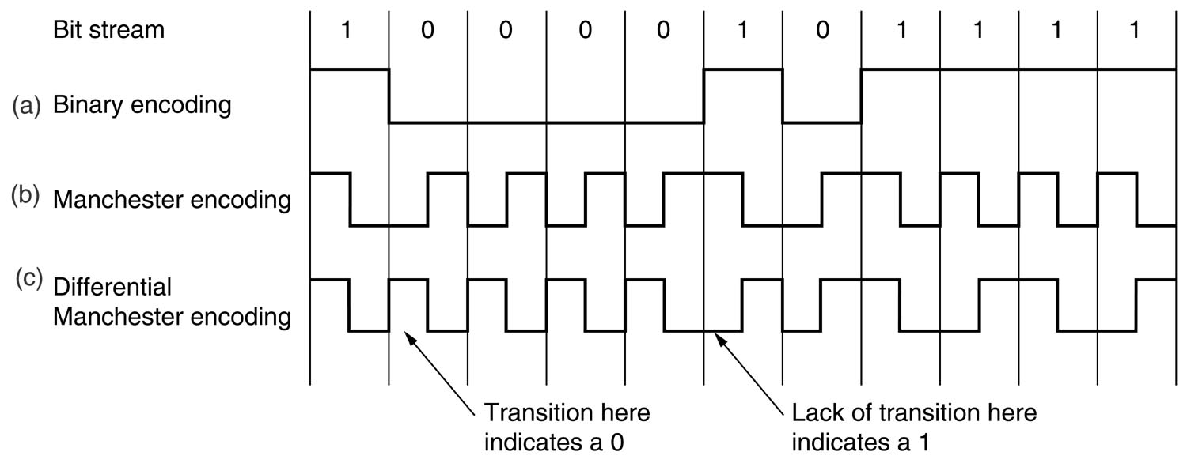
Biphase
Biphase is an encoding scheme in which signal changes at the middle of the bit interval but does not return to zero. The signal level is checked twice for every bit time, both initially and in the middle.
Biphase encoding is implemented in two different ways:
Manchester (According to GE Thomson)
In this type of coding, the transition is done at the middle of the bit-interval. The transition for the resultant pulse is from High to Low in the middle of the interval, for the input bit 1. While the transition is from Low to High for the input bit 0.
Manchester (According to IEEE standard(by default))
In this type of coding, the transition is done at the middle of the bit-interval. The transition for the resultant pulse is from High to Low in the middle of the interval, for the input bit 0. While the transition is from Low to High for the input bit 1.
Differential Manchester
In this type of coding, there always occurs a transition in the middle of the bit interval. If there occurs a transition at the beginning of the bit interval, then the input bit is 0. If no transition occurs at the beginning of the bit interval, then the input bit is 1.

Slide 9
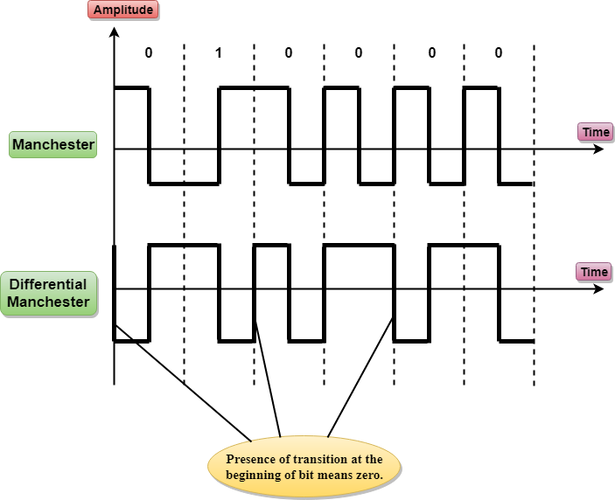
According to IEEE standard.

Slide 10
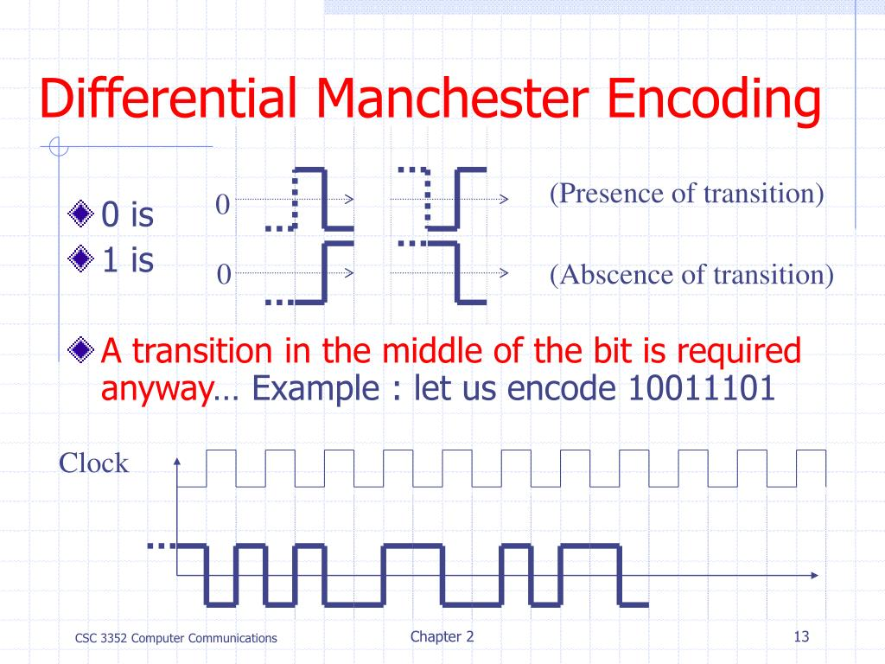

Slide 11
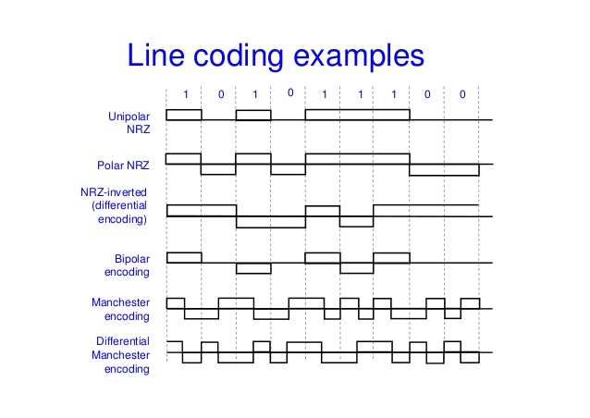

Slide 12
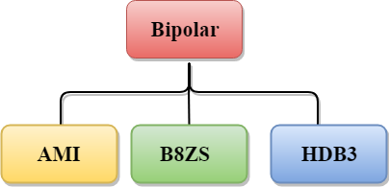
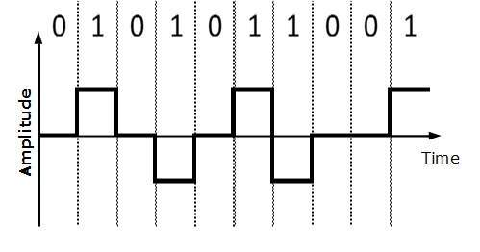
Bipolar Encoding
AMI
AMI stands for alternate mark inversion where mark work comes from telegraphy which means 1. So, it can be redefined as alternate 1 inversion.
In Bipolar AMI encoding scheme, 0 bit is represented by zero level and 1 bit is represented by alternating positive and negative voltages.

Slide 13
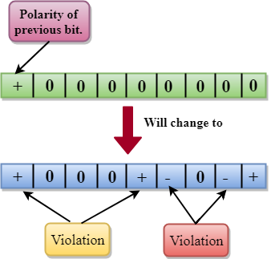
Advantage:
DC component is zero.
Sequence of 1s bits are synchronized.
Disadvantage:
This encoding scheme does not ensure the synchronization of a long string of 0s bits.
B8ZS
B8ZS stands for Bipolar 8-Zero Substitution.
This technique is adopted in North America to provide synchronization of a long sequence of 0s bits.
In most of the cases, the functionality of B8ZS is similar to the bipolar AMI, but the only difference is that it provides the synchronization when a long sequence of 0s bits occur.
B8ZS ensures synchronization of a long string of 0s by providing force artificial signal changes called violations, within 0 string pattern.
When eight 0 occurs, then B8ZS implements some changes in 0s string pattern based on the polarity of the previous 1 bit.
If the polarity of the previous 1 bit is positive, the eight 0s will be encoded as zero, zero, zero, positive, negative, zero, negative, positive.
If the polarity of previous 1 bit is negative, then the eight 0s will be encoded as zero, zero, zero, negative, positive, zero, positive, negative.

Slide 14
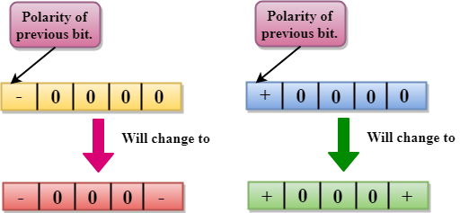
HDB3
HDB3 stands for High-Density Bipolar 3.
HDB3 technique was first adopted in Europe and Japan.
HDB3 technique is designed to provide the synchronization of a long sequence of 0s bits.
In the HDB3 technique, the pattern of violation is based on the polarity of the previous bit.
When four 0s occur, HDB3 looks at the number of 1s bits occurred since the last substitution.
If the number of 1s bits is odd, then the violation is made on the fourth consecutive of 0. If the polarity of the previous bit is positive, then the violation is positive. If the polarity of the previous bit is negative, then the violation is negative.
If the number of 1s bits since the last substitution is odd.

Slide 15
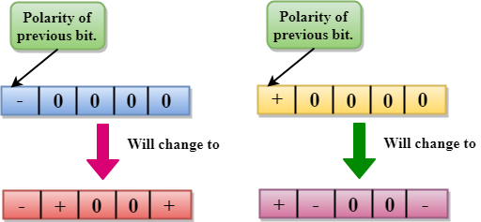
If the number of 1s bits is even, then the violation is made on the place of the first and fourth consecutive 0s. If the polarity of the previous bit is positive, then violations are negative, and if the polarity of the previous bit is negative, then violations are positive.
If the number of 1s bits since the last substitution is even.

Slide 16
Benefits or advantages of NRZ encoding
Following are the benefits or advantages of NRZ encoding:
➨It is simple line coding technique than RZ type as pulse does not return to zero while mapping binary data (1's and 0's).
➨For unipolar NRZ signaling less bandwidth is needed.
➨In polar NRZ and bipolar NRZ, no low frequency components are present in the signaling waveforms after mapping.
Drawbacks or disadvantages of NRZ line coding
Following are the drawbacks or disadvantages of NRZ line coding:
➨Presence of low frequencies may cause droop in the signal waveforms.
➨No error correction is done.
➨Long string of ones and zeros lead to loss of synchronization between clocks of transmitter and receiver. Hence separate clock line is required between transmitter and receiver to eliminate this problem.
➨No clock is available.
############## Notes abt DC
The use of a bipolar code prevents a significant build-up of DC, as the positive and negative pulses average to zero volts. Little or no DC-component is considered an advantage because the cable may then be used for longer distances and to carry power for intermediate equipment such as line repeaters. No DC component (or say low-frequency component) should be there because it can't be transferred to larger distances. Signals creates very low frequencies when the voltage level in a digital signal is constant for a while. ... These frequencies around zero are called DC components, creates problems for a system that cannot pass low frequencies or system that uses electrical coupling eg Transformer.
Synchronization---uniquely detectable code—represents 0’s and 1’s clearly . If there is an error, detection can be done easily.

Slide 17
ANALOG-TO-DIGITAL CONVERSION
When an analog signal is digitalized, this is called an analog-to-digital conversion.
Suppose human sends a voice in the form of an analog signal, we need to digitalize the analog signal which is less prone to noise. It requires a reduction in the number of values in an analog message so that they can be represented in the digital stream.
In analog-to-digital conversion, the information contained in a continuous wave form is converted in digital pulses.
Techniques for Analog-To-Digital Conversion
PAM
PAM stands for pulse amplitude modulation.
PAM is a technique used in analog-to-digital conversion.
PAM technique takes an analog signal, samples it, and generates a series of digital pulses based on the result of sampling where sampling means measuring the amplitude of a signal at equal intervals.
PAM technique is not useful in data communication as it translates the original wave form into pulses, but these pulses are not digital. To make them digital, PAM technique is modified to PCM technique.

Slide 18
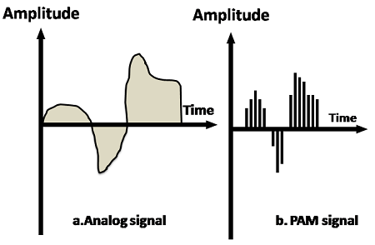
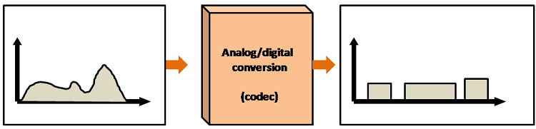


Slide 19
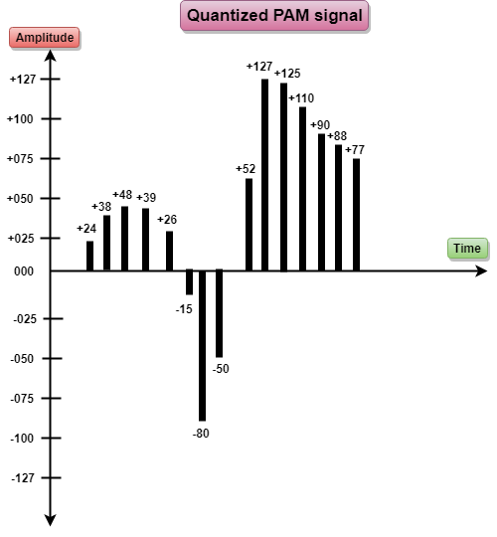
PCM
PCM stands for Pulse Code Modulation.
PCM technique is used to modify the pulses created by PAM to form a digital signal. To achieve this, PCM quantizes PAM pulses. Quantization is a process of assigning integral values in a specific range to sampled instances.
PCM is made of four separate processes: PAM, quantization, binary encoding, and digital-to-digital encoding.

Slide 20
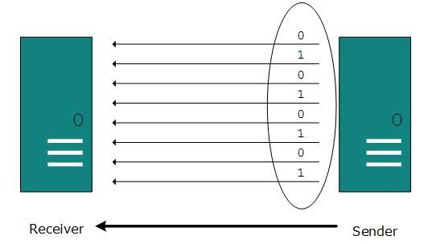
Transmission Modes
The transmission mode decides how data is transmitted between two computers.The binary data in the form of 1s and 0s
can be sent in two different modes: Parallel and Serial.
Parallel Transmission
The binary bits are organized in-to groups of fixed length. Both sender and receiver are connected in parallel with the equal number of data lines. Both computers distinguish between high order and low order data lines. The sender sends all the bits at once on all lines. Because the data lines are equal to the number of bits in a group or data frame, a complete group of bits (data frame) is sent in one go. Advantage of Parallel transmission is high speed and disadvantage is the cost of wires, as it is equal to the number of bits sent in parallel. But there is a significant disadvantage: cost. Parallel transmission requires n communication lines (wires in the example) just to transmit the data stream. Because this is expensive, parallel transmission is usually limited to short distances.

Slide 21
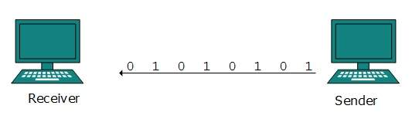
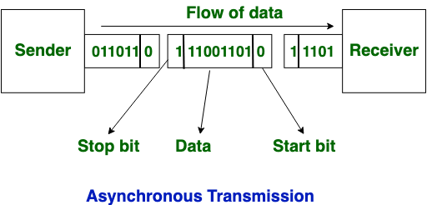
Serial Transmission
In serial transmission, bits are sent one after another in a queue manner. Serial transmission requires
only one communication channel.
Serial transmission can be either asynchronous or synchronous.
Asynchronous Serial Transmission
It is named so because there is no importance of timing. Data-bits have specific pattern and they help receiver recognize the start and end data bits. For example, a 0 is prefixed on every data byte and one or more 1s are added at the end.
Two continuous data-frames (bytes) may have a gap between them.

Slide 22
Asynchronous Transmission
In asynchronous transmission, data moves in a half-paired approach, 1 byte or 1 character at a time. It sends the data in a constant current of bytes. The size of a character transmitted is 8 bits, with a parity bit added both at the beginning and at the end, making it a total of 10 bits. It doesn’t need a clock for integration—rather, it utilises the parity bits to tell the receiver how to translate the data.
It is straightforward, quick, cost-effective, and doesn’t need 2-way communication to function.
Characteristics of Asynchronous Transmission
Each character is headed by a beginning bit and concluded with one or more end bits.
There may be gaps or spaces in between characters.
Examples of Asynchronous Transmission
Emails
Forums
Letters
Radios
Televisions
Use half duplex mode

Slide 23
Synchronous Serial Transmission
In synchronous transmission, data moves in a completely paired approach, in the form of chunks or frames. Synchronisation between the source and target is required so that the source knows where the new byte begins, since there are no spaces included between the data.
Synchronous transmission is effective, dependable, and often utilised for transmitting a large amount of data. It offers real-time communication between linked devices.
Timing in synchronous transmission has importance as there is no mechanism followed to recognize start and end data bits. There is no pattern or prefix/suffix method. Data bits are sent in burst mode without maintaining gap between bytes (8-bits). Single burst of data bits may contain a number of bytes. Therefore, timing becomes very important.
It is up to the receiver to recognize and separate bits into bytes.The advantage of synchronous transmission is high speed, and it has no overhead of extra header(start bit 0) and footer bits(stopbit 1) as in asynchronous transmission.
Because there are no beginning and end bits, the data transfer rate is quicker but there’s an increased possibility of errors occurring. Over time, the clocks will get out of sync, and the target device would have the incorrect time, so some bytes could become damaged on account of lost bits. To resolve this issue, it’s necessary to regularly re-synchronise the clocks, as well as to make use of check digits to ensure that the bytes are correctly received and translated.
Characteristics of Synchronous Transmission
There are no spaces in between characters being sent.
Timing is provided by modems or other devices at the end of the transmission.
Special ’syn’ characters goes before the data being sent.
The syn characters are included between chunks of data for timing functions.
Examples of Synchronous Transmission
Chatrooms
Video conferencing
Telephonic conversations
Face-to-face interactions
Use Full duplex mode

Slide 24
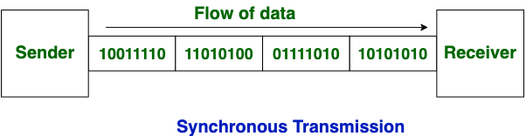

Slide 25
S.NO | Synchronous Transmission | Asynchronous Transmission
1. | In Synchronous transmission, Data is sent in form of blocks or frames. | In asynchronous transmission, Data is sent in form of byte or character.
2. | Synchronous transmission is fast. | Asynchronous transmission is slow.
3. | Synchronous transmission is costly. | Asynchronous transmission is economical.
4. | In Synchronous transmission, time interval of transmission is constant. | In asynchronous transmission, time interval of transmission is not constant, it is random.
5. | In Synchronous transmission, There is no gap present between data. | In asynchronous transmission, There is present gap between data.
6. | Efficient use of transmission line is done in synchronous transmission. | While in asynchronous transmission, transmission line remains empty during gap in character transmission.
7. | Synchronous transmission needs precisely synchronized clocks for the information of new bytes. | Asynchronous transmission have no need of synchronized clocks as parity bit is used in this transmission for information of new bytes.

Slide 26
a specific range of frequencies in the radio frequency (RF) spectrum, which is divided among ranges from very low frequencies (vlf) to extremely high frequencies (ehf). Each band has a defined upper and lower frequency limit.

